Slide 1
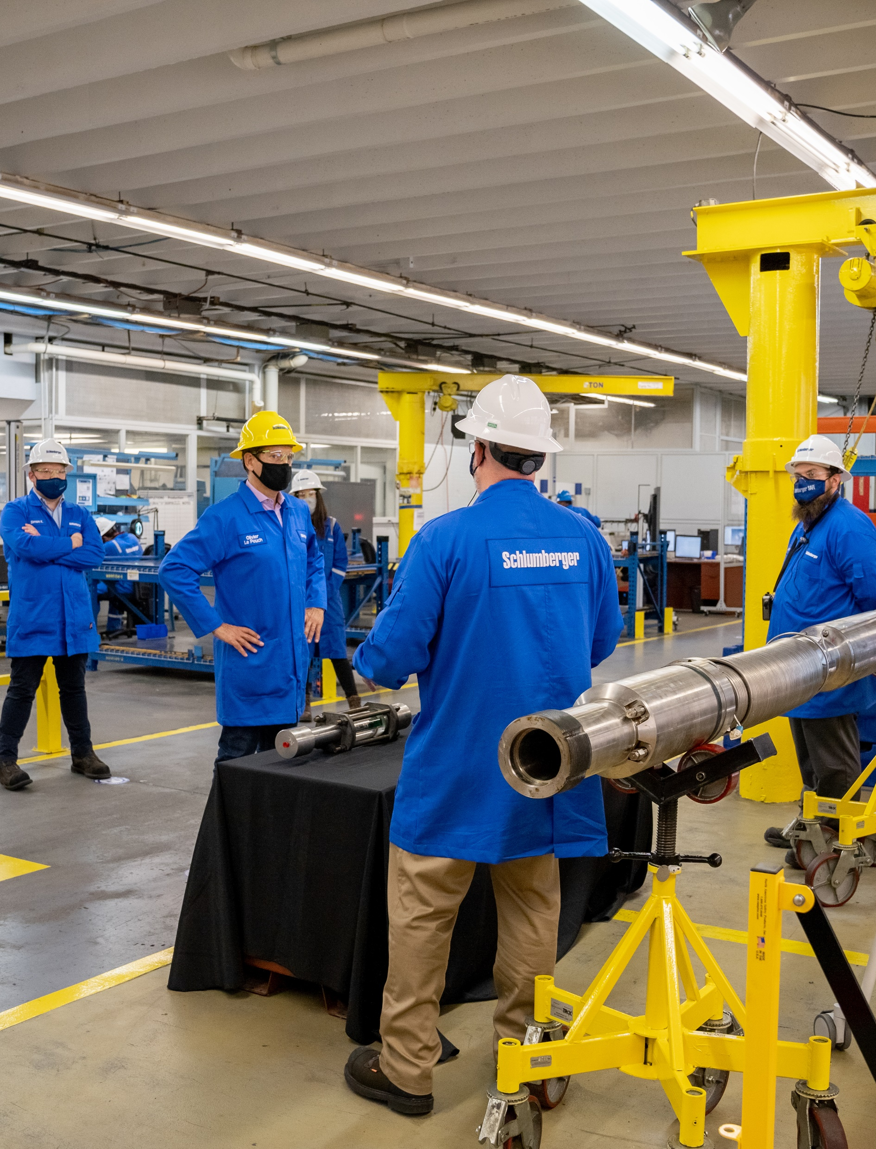

Customer Service Macro
Guide
Digital Cell Team: 09/01/2022

Slide 2
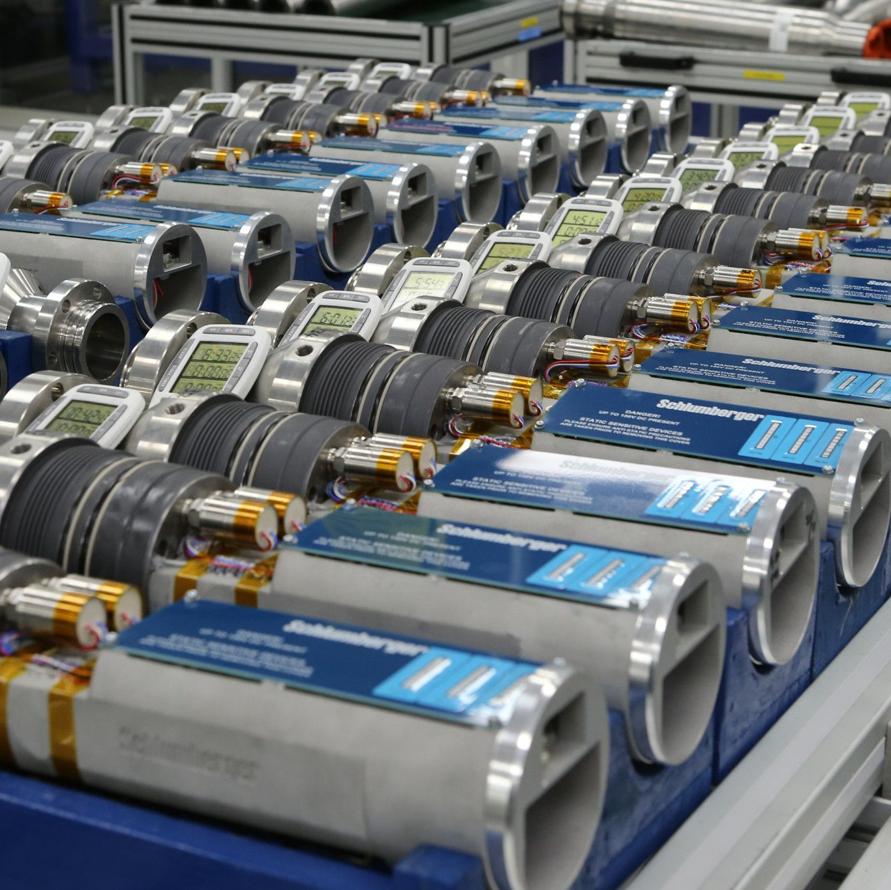
Summary
Notification Phase
Consolidation Phase

Slide 3
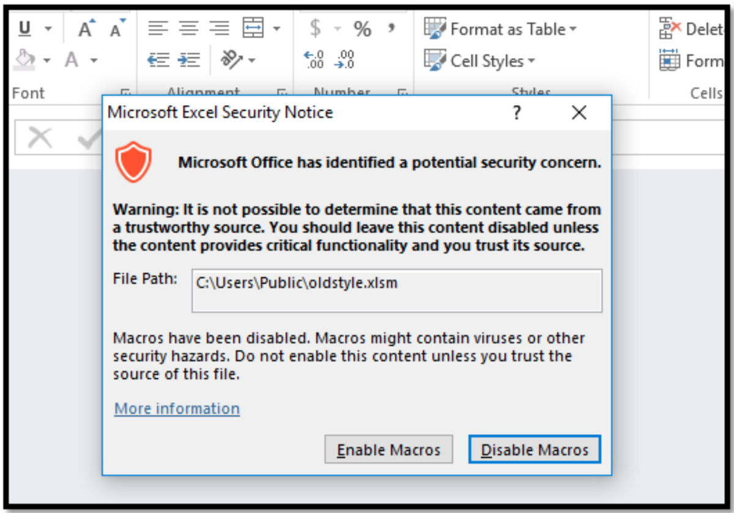
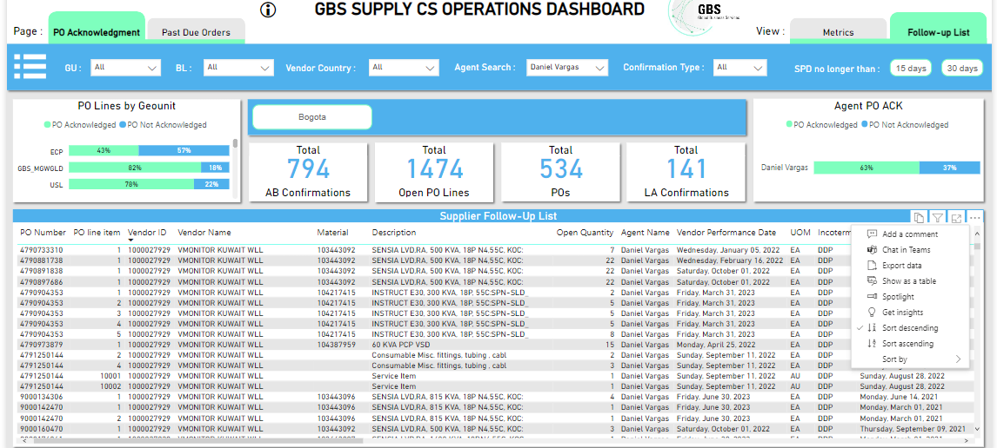
1. Notification Phase
Step 1: Open the file, in case you get the Security Notice pop up make sure to select the Enable Macros option.
Step 2: Browse the CS Proactive PO Management and export as summarized data the report on the Follow-up View.

Slide 4
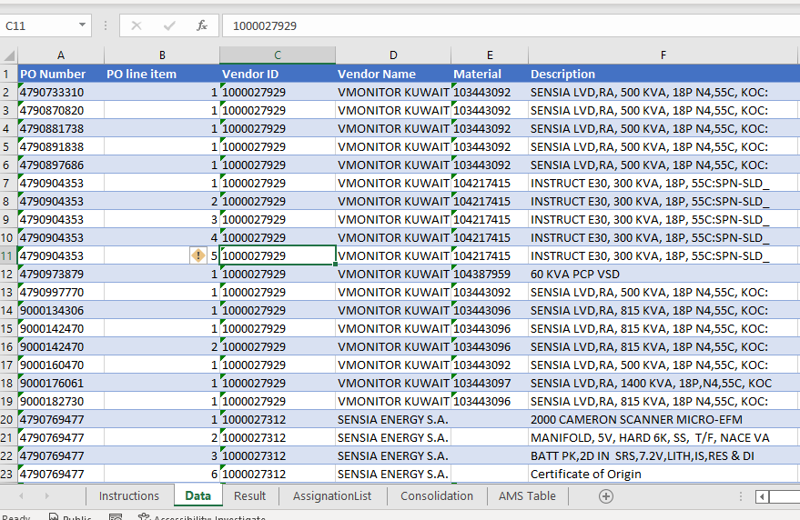
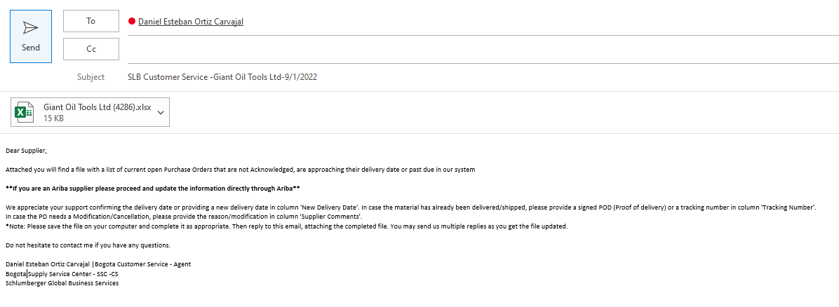
1. Notification Phase
Step 3: Copy the data downloaded to the “Data” tab in the macro and keep just the lines you want to send. Make sure the headers are copied in the first row.
Step 4: Select either if you want to review every email to the suppliers before sending them or if you want to send them automatically.
Note: In case you select Yes, all the emails will show up as in the image before sending

Slide 5
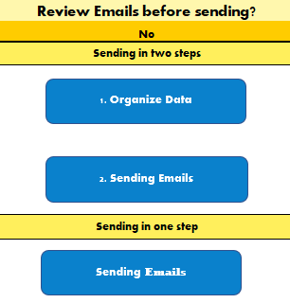
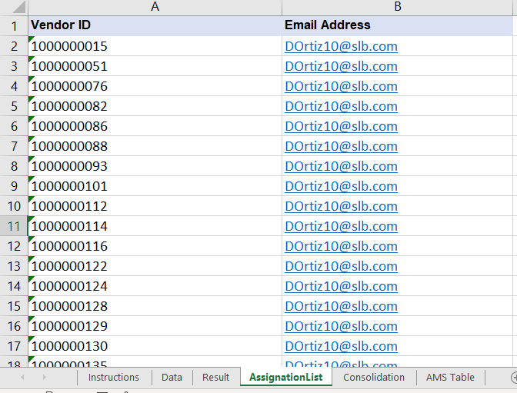
1. Notification Phase
Step 5: Run the macro with one of the following options:
A) Two steps:
1. Click the Organize Data button and review the format on the “Result tab”
2. After reviewing the data send the email by clicking the second button.
B) One step:
1. Click the Sending Emails button to automatically mail to the suppliers
Note: Before running the macro make sure to have all the supplier contacts on the “AssignationList” tab

Slide 6
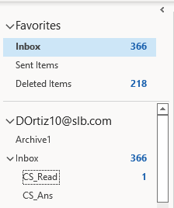
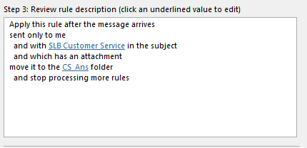
2. Consolidation Phase
Step 1: On your email create two folders inside the Inbox with the following names:
A) CS_Ans: This folder will contain all the new answers that needs to be consolidated.
B) CS_Read: This folder will contain all the supplier answers that were previously consolidated.
Step 2: Create a rule on outlook to save automatically the emails on the corresponding folder as is shown in the image at the left. You may need to click on the advance options.
*Note: Step 1 and 2 needs to be done just the first time

Slide 7
2. Consolidation Phase
Step 3: Open the file, in case you get the Security Notice pop up make sure to select the Enable Macros option.
Step 4: Browse the CS Proactive PO Management and export as summarized data the report on the Follow-up View.

Slide 8
2. Notification Phase
Step 5: Copy the data downloaded to the Data tab in the current file. This will be the information use to create the mass upload.
Step 6: Click the Consolidation Phase Button.

Slide 9
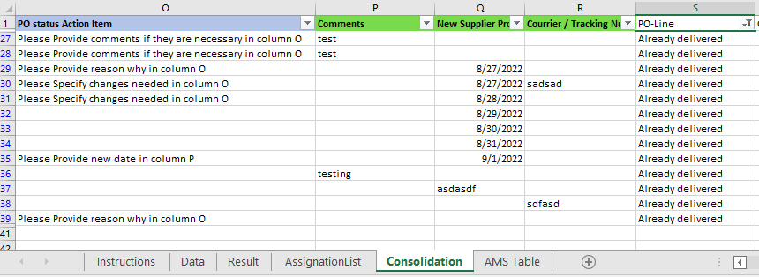
2. Notification Phase
Step 7: Review the Consolidation Report on the “Consolidation” Tab. Put attention on the “Already delivered” Lines that are shown in column S, these lines were not found in the Report pasted on the data tab and may need to be review by the Agent.
Step 6: Review and save the mass upload file created automatically by the macro. Then Submit into SAP through the transaction ZSUP_POACK

